Slide 1
Software Analysis and Design (CS:324)
Course Instructor: Romasha Khurshid
Email Address: Romasha.Khurshid@nu.edu.pk
Reference Book:
Software Engineering
By Ian Sommervile
10 Edition

Slide 2
Requirement Engineering: SDA
Requirements:
It may range from a high-level abstract statement of a service or of a system constraint to a detailed mathematical functional specification.
This is inevitable as requirements may serve a dual function
May be the basis for a bid for a contract - therefore must be open to interpretation;
May be the basis for the contract itself - therefore must be defined in detail;
Both these statements may be called requirements.

Slide 3


Types of Requirement:
User Requirement:
Written for customers.
Often written in natural language (no technical details)
System Requirement:
Written for developers
Detailed functional and non-functional requirements discussed.
Include clear implementation details

Slide 4
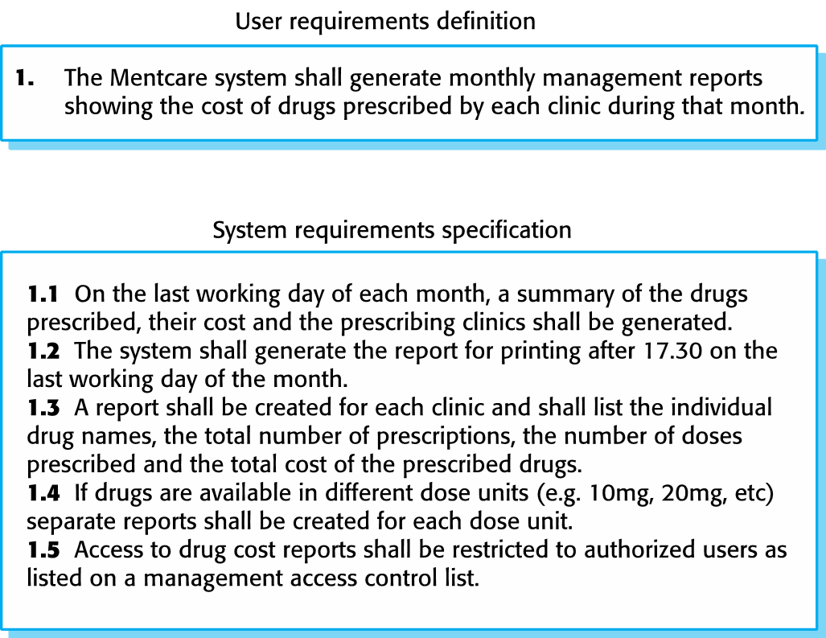
User and System Requirements:

Slide 5

System stakeholders:
Any person or organization who is affected by the system in some way and so who has a legitimate interest
Stakeholders:
End users
System managers
System owners
External stakeholders

Slide 6
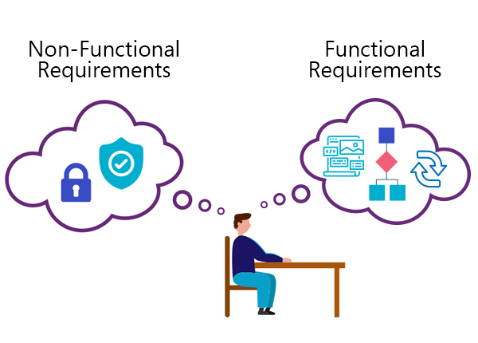
Functional and Non-Functional Requirements:
Functional Requirements:
Statements of services the system should provide
How the system should react to particular inputs and in particular situations.
May state what the system should not do
Non-functional requirements:
Constraints on the services or functions offered by the system such as timing constraints, constraints on the development process, standards, etc.
Similar to Quality attributes
Non-functional requirements may be more critical than functional requirements. If these are not met, the system may be useless

Slide 7
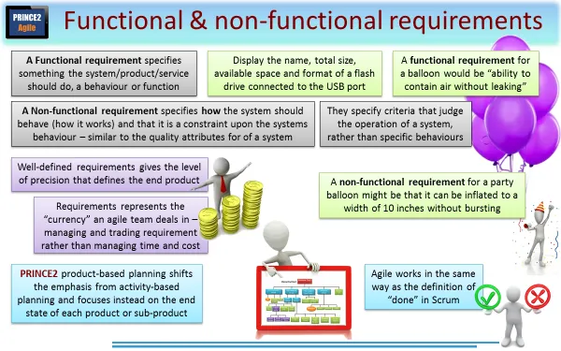
Little more…
Describe functionality or system services.
Functional user requirements may be high-level statements of what the system should do.
Functional system requirements should describe the system services in detail.

Slide 8
Mentcare system: functional requirements
A user shall be able to search the appointments lists for all clinics.
The system shall generate each day, for each clinic, a list of patients who are expected to attend appointments that day.
Each staff member using the system shall be uniquely identified by his or her 8-digit employee number.

Slide 9
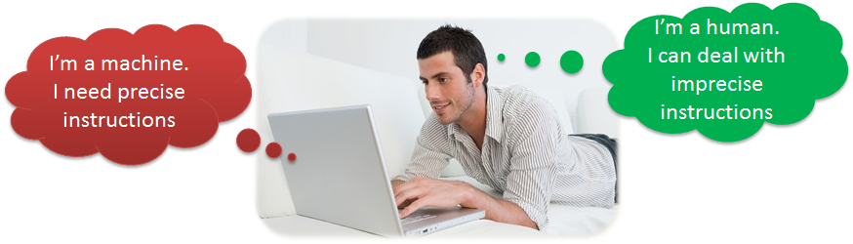
Requirements imprecision:
Problems arise when functional requirements are not precisely stated.
Ambiguous requirements may be interpreted in different ways by developers and users.
Consider the term ‘search’ in requirement 1
User intention – search for a patient name across all appointments in all clinics;
Developer interpretation – search for a patient name in an individual clinic. User chooses clinic then search

Slide 10
Requirements completeness and consistency:
In principle, requirements should be both complete and consistent.
Complete:
They should include descriptions of all facilities required.
Consistent:
There should be no conflicts or contradictions in the descriptions of the system facilities.
In practice, because of system and environmental complexity, it is impossible to produce a complete and consistent requirements document.

Slide 11
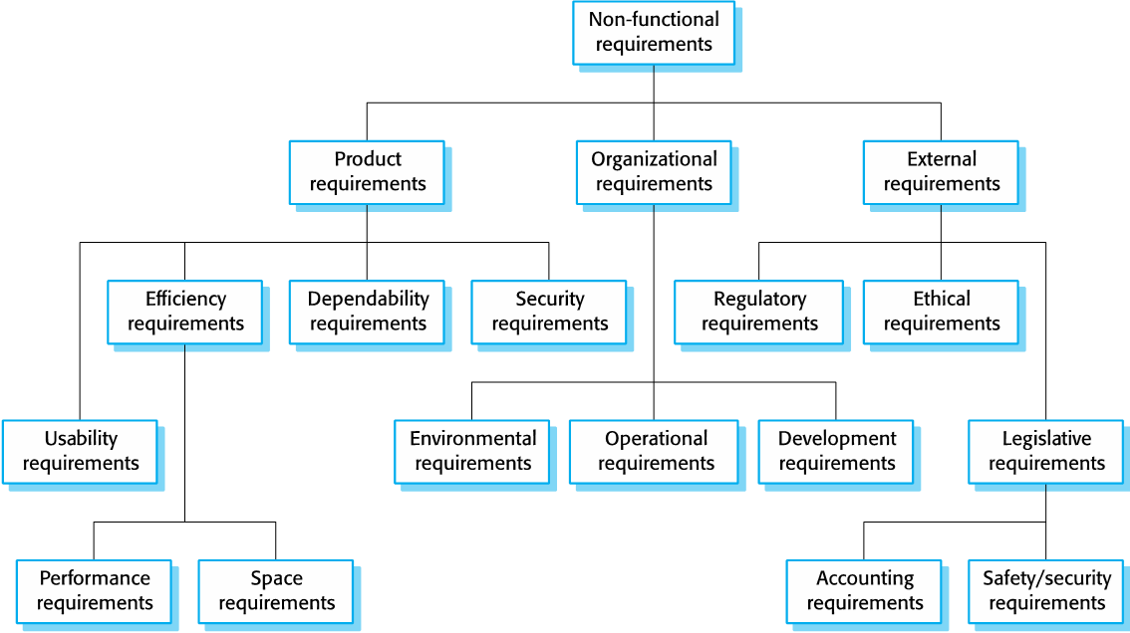
Types of non-functional requirement (Home Assignment)

Slide 12
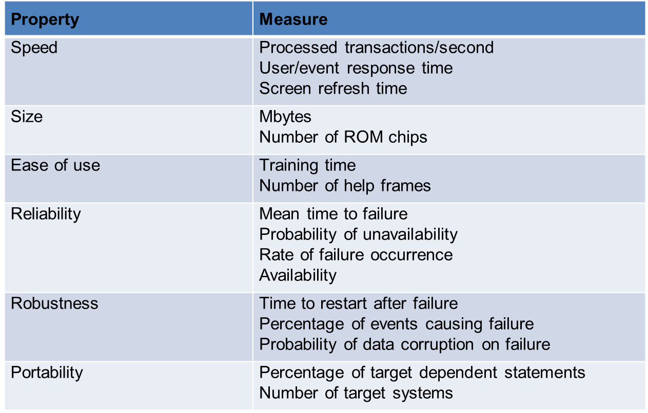
Metrics for specifying non-functional requirements:

Slide 13
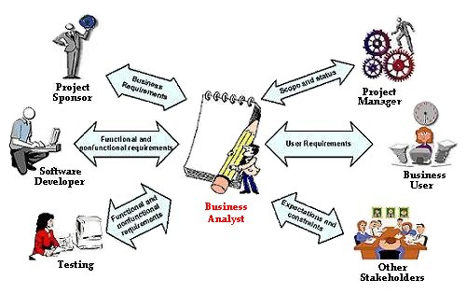
Requirement Engineering:

Slide 14
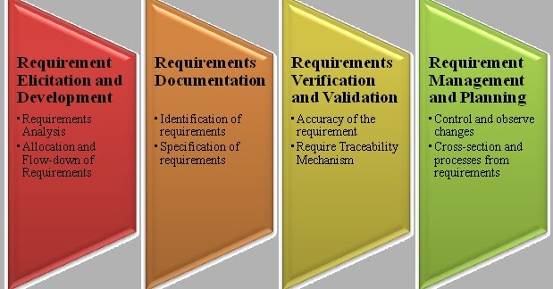
Requirements engineering:
The process of finding out, analyzing, documenting and checking these services and constraints is called requirements engineering (RE).
Requirements engineering processes:
However, there are a number of generic activities common to all processes
Requirements elicitation and analysis;
Requirements specification;
Requirements validation;
Requirements management;

Slide 15
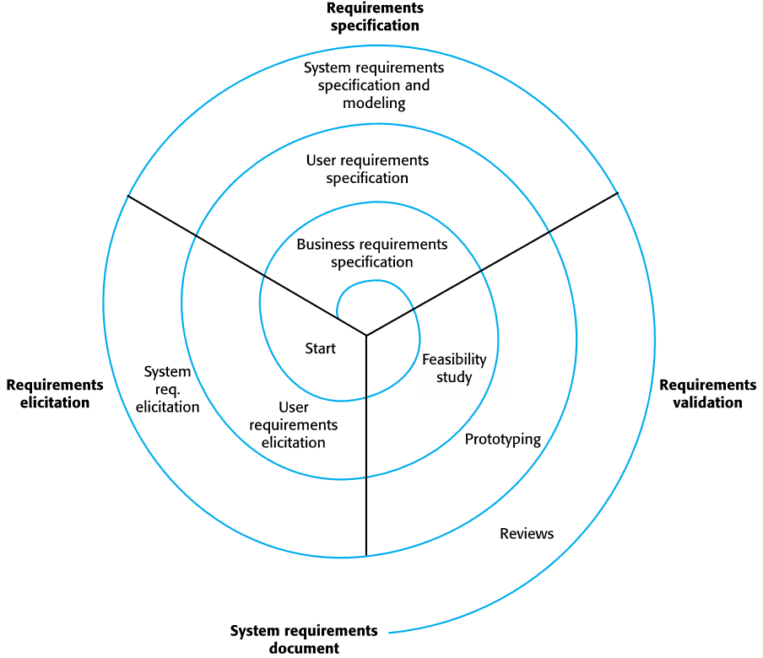
A spiral view of the requirements engineering process :

Slide 16
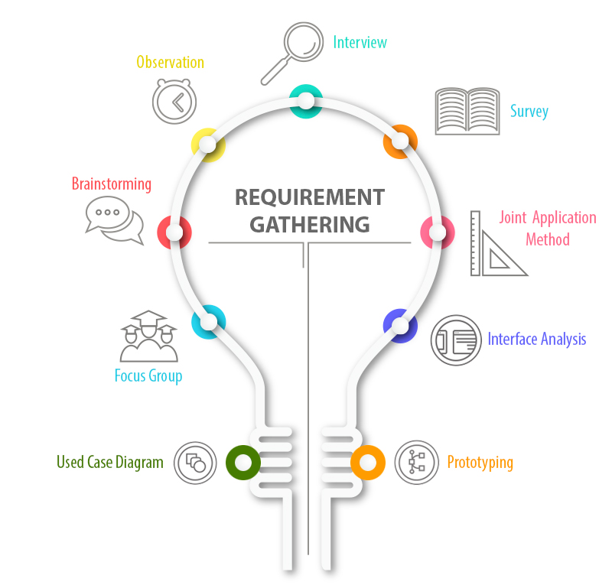
Requirements elicitation

Slide 17
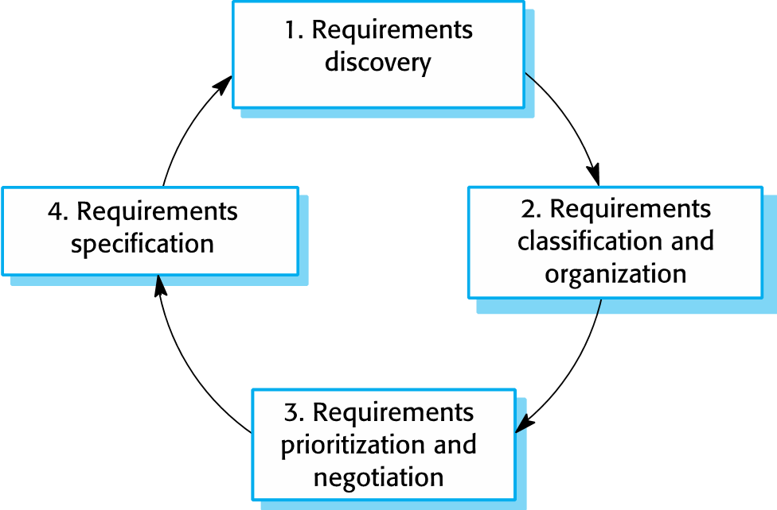
Stages of Requirement Elicitation:

Slide 18
Process activities:
Requirements discovery
Interacting with stakeholders to discover their requirements. Domain requirements are also discovered at this stage.
Requirements classification and organization
Groups related requirements and organizes them into coherent clusters.
Prioritization and negotiation
Prioritizing requirements and resolving requirements conflicts.
Requirements specification
Requirements are documented and input into the next round of the spiral.

Slide 19
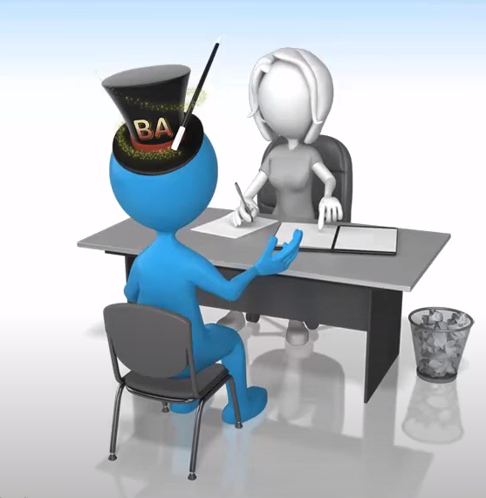
Interviewing:
Formal or informal interviews with stakeholders are part of most RE processes.
Types of interview
Closed interviews based on pre-determined list of questions.
Open interviews where various issues are explored with stakeholders.

Slide 20



Interviews can be….
One-to-one interviews
Group interviews
Written Interviews

Slide 21
Problems with interviews:
Application specialists may use language to describe their work that isn’t easy for the requirements engineer to understand.
Interviews are not good for understanding domain requirements
Requirements engineers cannot understand specific domain terminology;
Some domain knowledge is so familiar that people find it hard to articulate or think that it isn’t worth articulating.

Slide 22
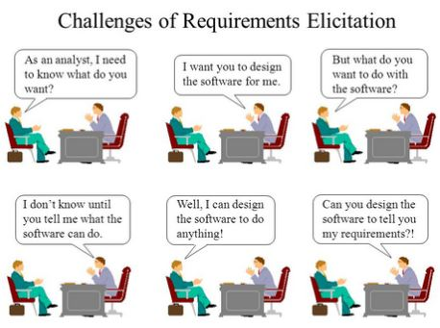
Sometimes we have customers like this…

Slide 23

Observation and Ethnographic Studies:
Ethnography is an indirect methodology where consumers’ natural behavior in their everyday environment is observed.
A social scientist spends a considerable time observing and analyzing how people actually work.
People do not have to explain or articulate their work.

Slide 24
Scope of ethnography:
Requirements that are derived from the way that people actually work rather than the way I which process definitions suggest that they ought to work.
Ethnography is effective for understanding existing processes but cannot identify new features that should be added to a system.

Slide 25
Passive Observation:
No interference with task performers
Active Observation:
You get involved in the task even become a team member.

Slide 26
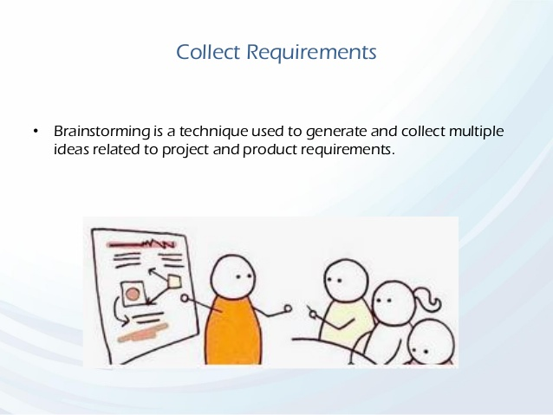
Brainstorming:
An informal debate is held among various stakeholders and their inputs are recorded for further requirements.

Slide 27
Stories and scenarios:
Scenarios and user stories are real-life examples of how a system can be used.
Stories and scenarios are a description of how a system may be used for a particular task.
Because they are based on a practical situation, stakeholders can relate to them and can comment on their situation with respect to the story.

Slide 28
Problems of requirements elicitation:
Stakeholders don’t know what they really want.
Stakeholders express requirements in their own terms.
Different stakeholders may have conflicting requirements.
The requirements change during the analysis process. New stakeholders may emerge and the business environment may change

Slide 29
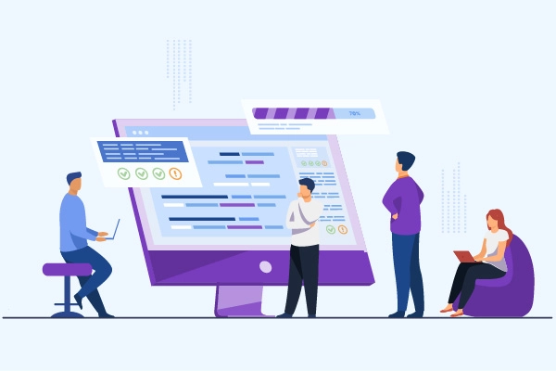
2. Requirements specification

Slide 30


Requirements specification
The process of writing down the user and system requirements in a requirements document.

Slide 31
Ways of writing a system requirements specification:
Notation | Description
Natural language | The requirements are written using numbered sentences in natural language. Each sentence should express one requirement.
Structured natural language | The requirements are written in natural language on a standard form or template. Each field provides information about an aspect of the requirement.
Graphical notations | Graphical models, supplemented by text annotations, are used to define the functional requirements for the system; UML use case and sequence diagrams are commonly used.
Mathematical specifications | These notations are based on mathematical concepts such as finite-state machines or sets. Although these unambiguous specifications can reduce the ambiguity in a requirements document, most customers don’t understand a formal specification. They cannot check that it represents what they want and are reluctant to accept it as a system contract

Slide 32
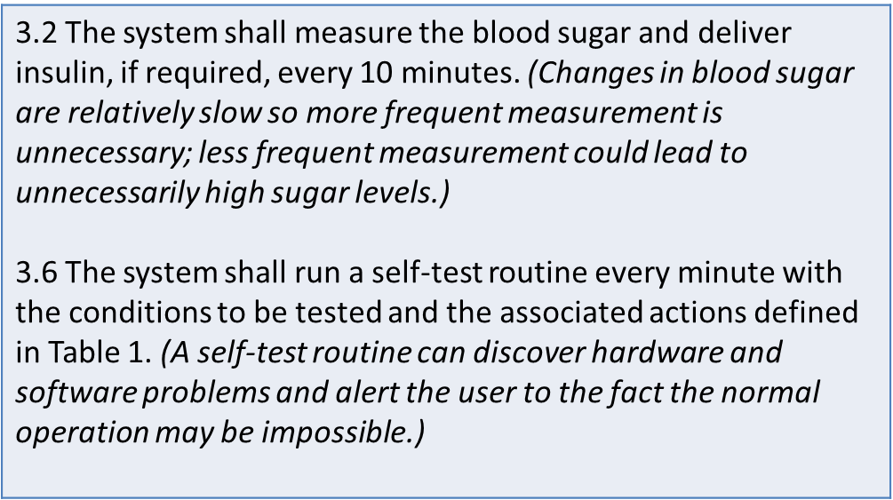
Example requirements for the insulin pump software system

Slide 33
A structured specification of a requirement for an insulin pump

Slide 34
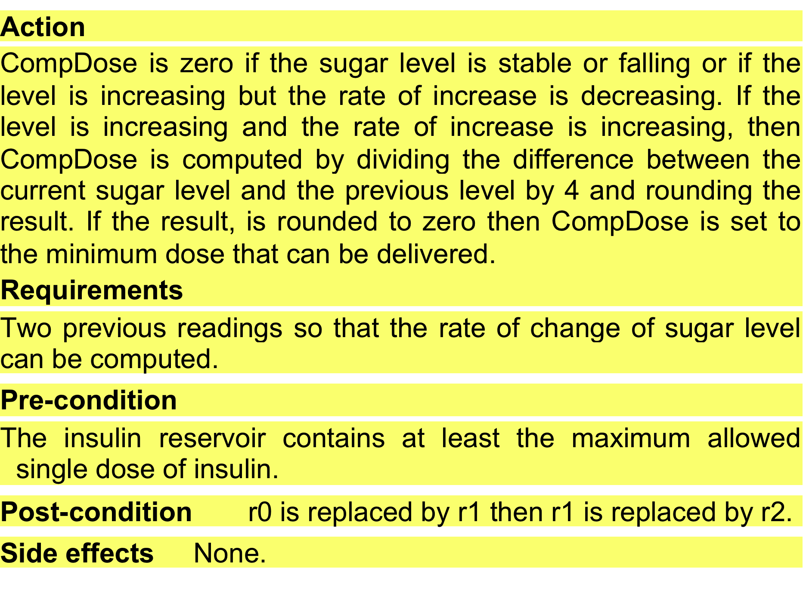
Continue…..

Slide 35
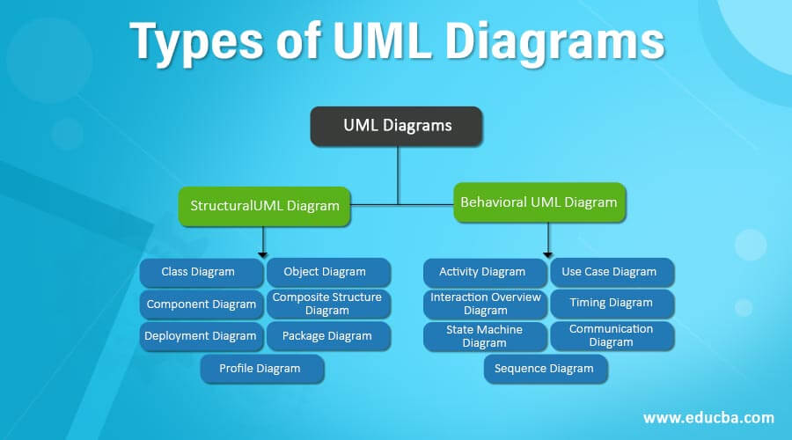
Unified Modeling Language(UML):
UML provides various types of diagram to represent the working of the system or software in pictorial format
UML Categorized into two:
Structural diagram
Behavioral diagram

Slide 36
Structural UML diagrams, as the name would suggest, show how the system is structured, including the classes, objects, packages, components, etc. in the system and the relationships between those elements.
Behavioral UML diagrams, These UML diagrams visualize how the system behaves and interacts with itself and with users, other systems, and other entities.

Slide 37
Use-Case Diagram:
Popular technique for capturing functional requirements, especially in software development..
Use case diagrams model how stakeholder interact with the system.
This type of UML diagram should be a high-level overview of the relationships between users and systems
It can be a great tool for explaining your system to a non-technical audience.

Slide 38
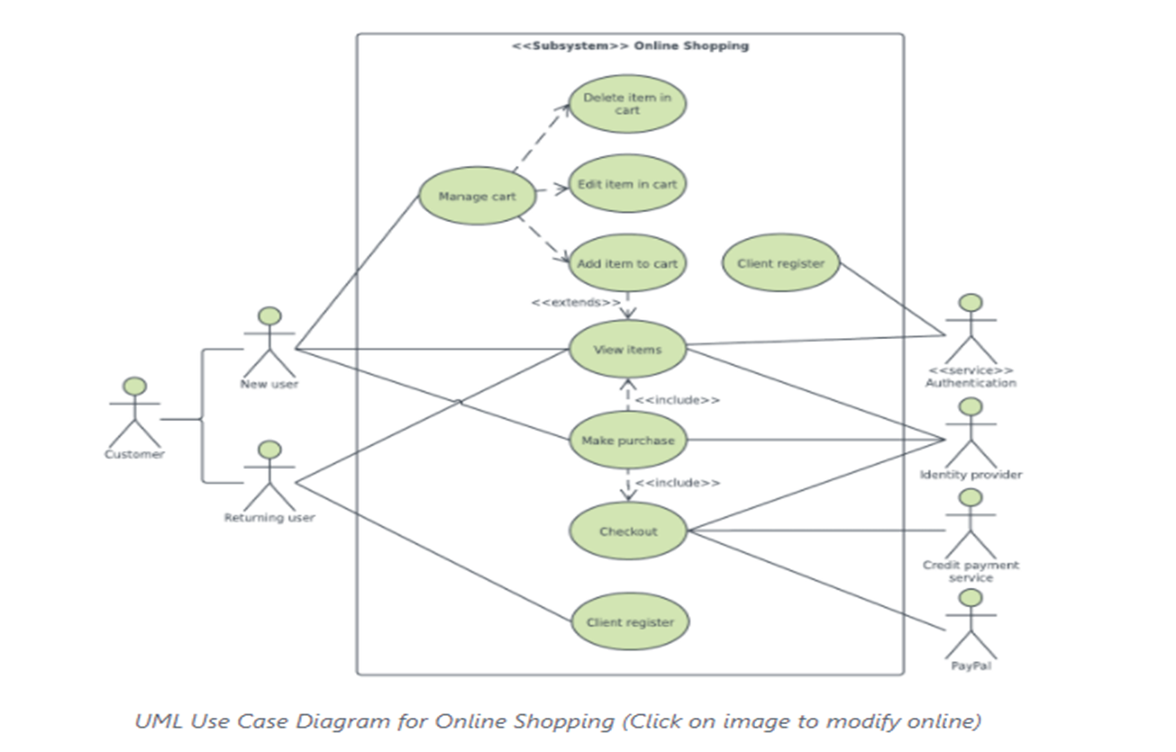
Purpose of Use Case Diagram:
Use case diagrams are typically developed in the early stage of development and people often apply use case modeling for the following purposes:
Specify the context of a system
Capture the requirements of a system
Validate systems architecture
Drive implementation and generate test cases
Developed by analysts together with domain experts

Slide 39
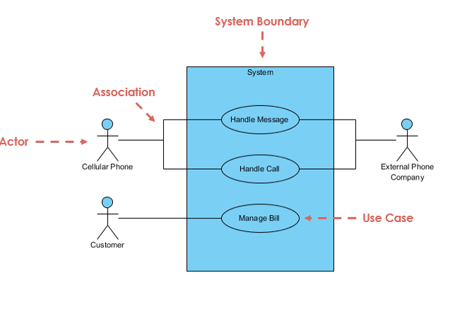
Elements of Use Case Diagram

Slide 40
1
Notation Description | Visual Representation
Actor Someone interacts with use case (system function). Named by noun. Actor plays a role in the business Actor has a responsibility toward the system (inputs), and Actor has expectations from the system (outputs).

Slide 41
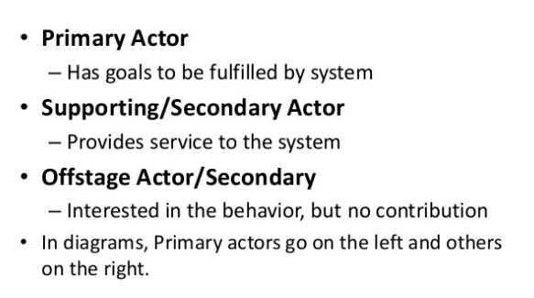
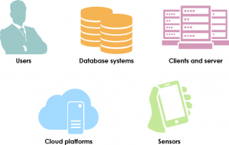

Types Of Actors:
Tips to identify actors…
Must serve as sources and destinations for data
Must be external to the system

Slide 42
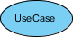
2
Use Case System function (process - automated or manual) Named by verb + Noun (or Noun Phrase). i.e. Do something Each Actor must be linked to a use case, while some use cases may not be linked to actors.

Slide 43
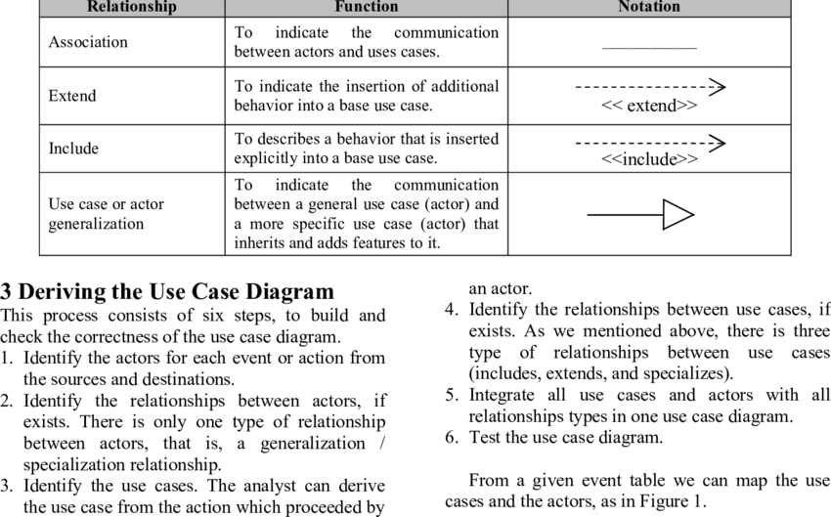
Relationship:
3
Types Of Relationship:

Slide 44
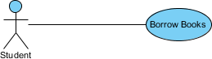
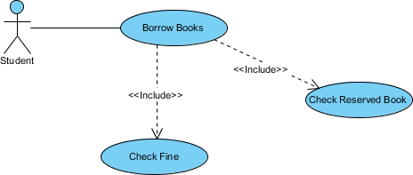
Relationships Examples…
Association Link
A Use Case diagram illustrates a set of use cases for a system, i.e. the actors and the relationships between the actors and use cases.
Include Relationship
The include relationship adds additional functionality not specified in the base use case.

Slide 45
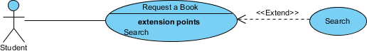
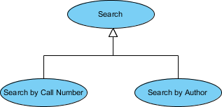
Continue….
The extend relationships are important because they show optional functionality or system behavior.
A generalization relationship means that a child use case inherits the behavior and meaning of the parent use case. The child may add or override the behavior of the parent. The figure below provides a use case example by showing two generalization connectors that connect between the three use cases.

Slide 46

4
Boundary of system The system boundary is potentially the entire system as defined in the requirements document.

Slide 47
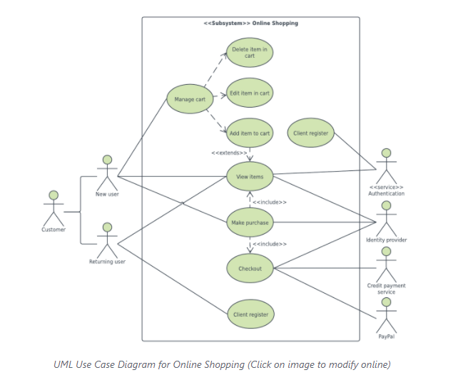
Example Use-Case

Slide 48
Detailed/Descriptive Use-Case
Elements of a Use Case:
Use Case Name - Brief description.
Actor – anyone or anything that performs a behavior (who is using the system)
Primary Actor – stakeholder who initiates an interaction with the system to achieve a goal
Preconditions – what must be true or happen before and after the use case runs.
Post-Conditions - A list of conditions that must be true when the Use Case ends.
Triggers – this is the event that causes the use case to be initiated.
Main success scenarios [Basic Flow] – use case in which nothing goes wrong.
Alternative paths [Alternative Flow] – these paths are a variation on the main theme. These exceptions are what happen when things go wrong at the system level
Exception- Exception is anything that leads to NOT achieving the use case's goal. .
Quality- Specify quality attribute.

Slide 49
QUIZ:
You are using a software product that allows users to create and use group messaging threads. Group chat participants can be added to a group chat and these participants can all see the messages sent in that thread.
Which of the following would be a trigger for the use case of sending a message to a group chat?
A, Participant has a message they want to send to the group.
B, Participant types out message.
C, Participants opens the group chat.
D, Participant taps the send button.

Slide 50
Use-Case levels:
Use-case can be written in different levels of detail. For example:
Brief use case: A few sentences summarizing the use-case.
Casual use-case: multiple paragraphs (often used in agile because they easy, quick to write and understandable for both customer and developer)
Main success Scenario: A customer arrives at a checkout with items to return. The cashier uses the POS system to record each returned items.
Alternate Scenarios: if the customer paid by credit. If the item identifier is not found in the system. If the system detects failure to communicate with the external accounting system .
3. Fully Dressed use case: A carefully structured and detailed description enabling a deep understanding of the goals, tasks, and requirements. Used when system is complex and has high risks.

Slide 51
Exercise…
An executive at a chain of family restaurants called Brampton's Pizza
and Pasta.
They are looking to develop some software for in-house use at their restaurants.
Their goal is to take the restaurant ordering process and make it more efficient.
She is thinking that customers should be able to view the menu of the restaurant they're
in, and once they're ready, place an order.
she'd really like there to be a kids' page where you can see the kids' menu.
Maybe there's a few games for the kids to play, but most importantly,
it should be easy enough to use that kids can make an order themselves.
customers should also be able to specify any changes they'd like to make
for their meal, and they should be able to list any dietary restrictions they may
have before they submit their order to the kitchen.
The kitchen should then be able to view these orders as they come in.
Customers should be able to view and pay their bill within the system.

Slide 52
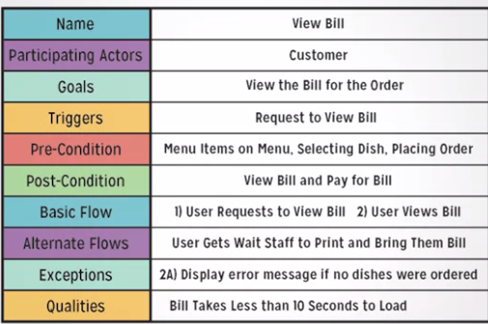
Solution…

Slide 53
Exercise….
Automated Teller Machine (ATM) is a banking system. This banking system allows customers or users to have access to financial transactions. These transactions can be done in public space without any need for a clerk, cashier, or bank teller. The user is authenticated when enters the plastic ATM card in a Bank ATM, Then enters the user name and PIN (Personal Identification Number). For every ATM transaction, a Customer Authentication is required and essential. User checks the bank balance as well as also demands the mini statement about the bank balance if they want. Then the user withdraws the money as per their need. If they want to deposit some money, they can do it. After complete action, the user closes the session. If there is any error or repair needed in Bank ATM, it is done by an ATM technician. ATM technician is responsible for the maintenance of the Bank ATM, upgrades for hardware, firmware or software, and on-site diagnosis.

Slide 54
Exercise…. Find Out Functional and Non-Functional Requirements in the scenario given?
The Problem:
Currently, there are no applications dedicated to students in universities. Students want to participate in university courses and see announcements in these courses, but have this information spread out on multiple websites, which are hard to find. They want to find fellow students with the same interests and share their opinion about courses and course material, however this is not possible yet. They also want to discuss exam questions and find the right place where the exam takes place without searching on Google.
Scenarios:
Jack, an incoming student from US, is studying computer science at TUM. He has business administration as minor subject and is already used to visit the courses in the computer science building. The business administration courses however, are located in a lecture hall in another building in the city center of Munich. He never visited the other building before, so he does not know how to find the lecture halls for his minor subject. He browses through the courses in the course catalog of the University App and finds the course “Foundations of Business Administration” with course times and the location of the lecture hall on a map. While he is attending the course, he makes contact with fellow students who also attend the course and reads their comments. He likes one comment “Great exercises” by Jenny, who is also studying informatics. From Jenny’s picture, he remembers that they met a week ago at the coffee machine. He requests friendship with Jenny (she might help him to pass the final) and adds a new comment about exam questions from earlier exams. While he is browsing, Jenny is notified about the friend request and accepts it. jack, in turn, is notified that Jenny has accepted his request and now browses through all the courses that Jenny is visiting. He finds another interesting course “Cost Accounting” that he wants to visit and saves it into his course list.

Slide 55
Possible Solution…
FR1: Search for available courses: A student can see all courses of the current semester in his major and minor subject. He is able to join the course which saves it into his course list. He can also drop a course.
FR2: Check course details: A student can see details about a course such as the course times, the location of the lecture hall on a map and other course attendees including their name and picture.
FR3: Update profile: A student can update his profile settings and his profile picture. He can also change the notification settings.
FR4: Add comments: A student can add comments about a course and thus start a discussion. Others can like the comment and write follow-up comments.
FR5: Request friendship: A student can request friendship with another student who then receives a notification about the request. The second student can accept and reject friendship which both notifies the first student.
FR6: Browse friends’ courses: A student can browse the courses of his friends.
FR7: View announcements: A student can view course announcements and comment/like them.
FR8: Post updates to timeline: A student can post updates to his timeline. Friends are notified about updates and can comment and like them. Certain updates are posted automatically such as saving a course into the course list or commenting on a course.
FR9: See course calendar: A student can see all courses in a calendar.

